Slide 1
Kernel module upload processing
Lecturer: Alex Libis
Project participants:
- Odelia Abbou
- Lior Zalta
- Alexander Ginzburg

Slide 2
table of contents
What is kernel module?
Reasons to write kernel module
.C file content
Makefile Content
Commands used in the uploading process of the kernel module
Example of a working kernel module
conclusion

Slide 3
What is a Kernel module?
Code that can be loaded/unloaded into kernel with the ability to extend functionality with hardware without rebooting the system.
Without the kernel modules:
the kernel space will use much more space than its currently using because, it will have to support every driver that would ever be needed.
every update to the kernel would require a reboot to the system.

Slide 4
Pros and Cons of the kernel module
Pros:
extend the functionality of the kernel without the need to reboot the system.
do not need to build the entire kernel in order to make any changes to a module.
saves memory because, we only load the needed module when we need to use it.
Cons:
Has the potential to crash the system, system crashes could corrupt the file system.

Slide 5
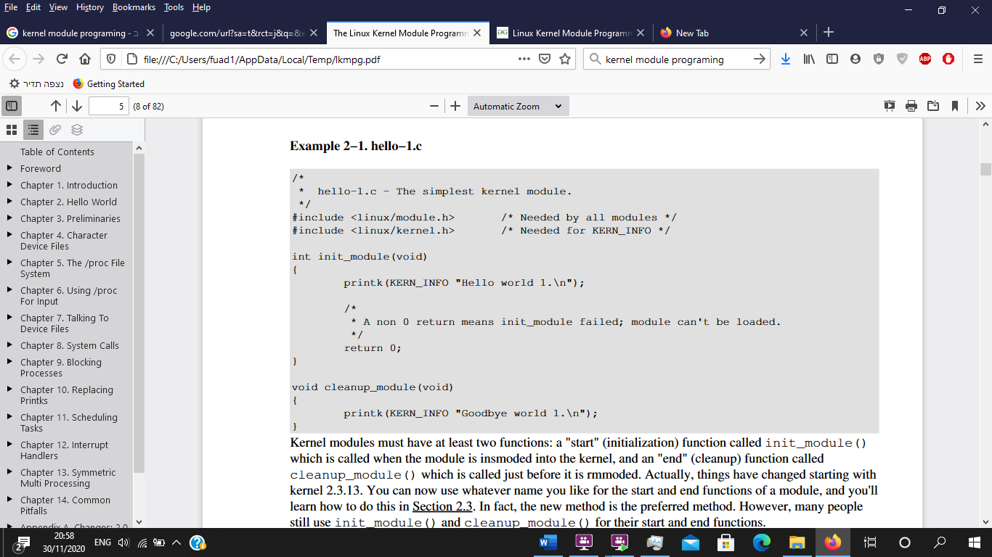
.C file content
Init_module is the "start" (initialization) function which is called when the module is insmoded (loaded) into the kernel.
cleanup_ module is the "end" (cleanup) function which is called just before the module is rmmoded (unloaded) from the kernel.
KERN_INFO is the “log level”.
Printk is a C function from the Linux kernel interface that prints messages to the kernel log.

Slide 6
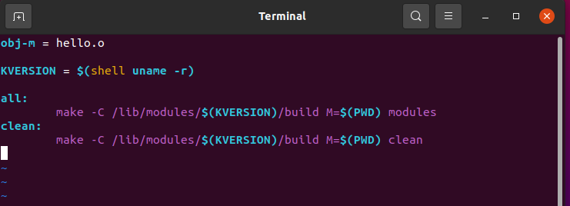
Makefile Content
Called a goal definition line, it defines the module that is going to be built.
Shortcut to shell uname –r, it’s a command that return the current kernel build version.
-C – switches to kernel directory mentioned in the same line
M=$(PWD) – M takes the address mentioned in pwd(command) (after switching ) and build the module.
Clean command to remove all the module files that were created with the make command

Slide 7
Commands used in the uploading process of the kernel module
lsmod – list all loaded modules
insmod [module_name.ko] – install a specific module
rmmod [module_name] – remove a module
Make all – compile the C code, builds the kernel module
Make clean – removes all the module files created by “make all”
dmesg - desplays kernel log
Side note: the commands insmod, rmmod, dmesg require sudo commands (super user authority )

Slide 8
Example of a working kernel module

Slide 9
Conclusion/ questions

